Slide 1






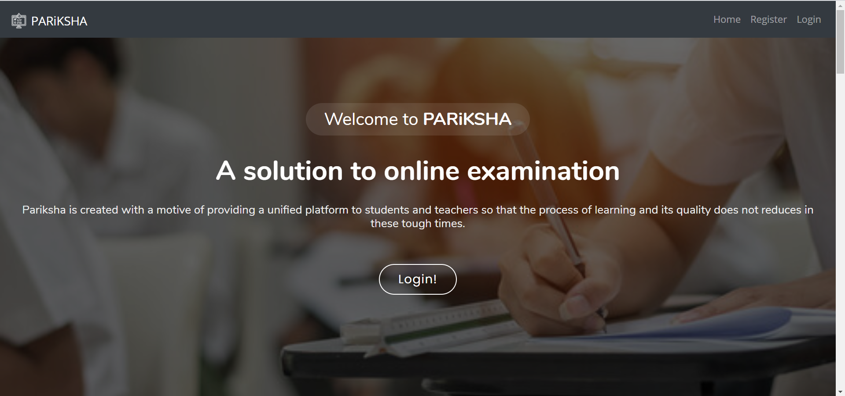
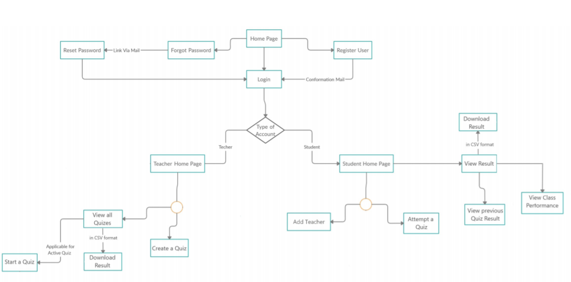
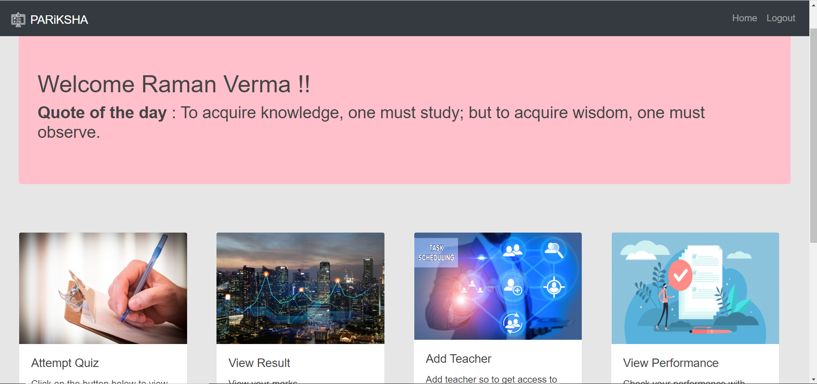
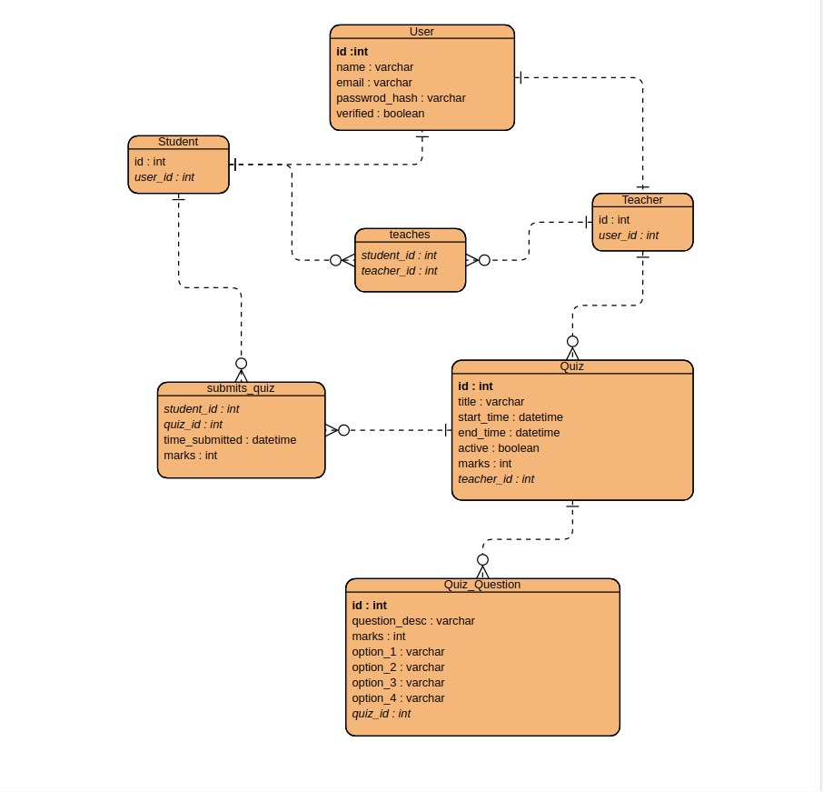
PARiKSHA
Third Semester Project , Bennett University, Greater Noida, India
Vibhu Upmanyu (E19CSE298) Pulkit Vyas (E19CSE284) Chirag Saxena (E19CSE124) Yoshi Bansal (E19CSE332) Anushka Garg (E19CSE252)
Dept. of Computer Science Engineering, Bennett University, India
Introduction
Techniques Utilized
We are developing a unified online platform in the form of a web application for conducting assessments, producing analytics and providing A.I. assisted proctoring facilities.
Problem
Current facilities do not provide integrated solution . The monitoring system becomes inefficient as the number of students attempting the exams increases the chances of an system crash increase.
User Interface/Demo Snapshots
Solution
PARiKSHA has an AI assisted alert system helping teachers conducting smooth exam . Hybrid Implementation to stop system crash even if load increases. PARiKSHA has it all be it Quiz, Crashproof website and A.I. assisted teaching.
Fig. 1. Block Diagram
Conclusion
This project is a small step in improving the quality and credibility of online examinations. The idea was to assist the teacher with the use of AI and hence reduce the man-power during invigilation. Our project was successful in building the various components that would be used to fulfil the task and hence this will serve as a prototype for idea behind the project.
Future Work
Integrate all these separate part of PARiKSHA in the webapp. Also , to add more variety of questions like True/False. Make the U.I. more reactive and responsive.Add profile / class view for teacher and students.
Fig. 2. ER Diagram

